Slide 1
COMMON CORE STANDARDS
P.E.N. Night Presentation

Slide 2
AGENDA
Reasons for the transition to the CCS
The difference
Organization and structure of the Common Core Standards (CCS)
The Standards in ELA and Math
Implementation of Standards

Slide 3
US ED STANDARDS
No Child Left Behind (NCLB) Requirements
  Establish standards
  Measure students’ mastery of those standards
  Accountability
NCLB did not
  Require same level of scrutiny for all standards
  Provide guidelines for alignment of standards across states

Slide 4
THE 21st WORK PLACE
Critical thinking and problem solving—ability to make decisions, solve problems, and take appropriate action
• Effective communication—ability to synthesize and transmit ideas both in written, digital and oral formats
• Collaboration and team building—ability to work effectively with others, including those from diverse groups and with opposing points of view
• Creativity and innovation—the ability to see what’s NOT there and make something happen; apply academic knowledge in new innovative ways
TOP 4 SKILLS identified by CEOs of 150 largest US companies
Are they ready to work? Report by the Partnership for the 21st Century Skills, 2008

Slide 5
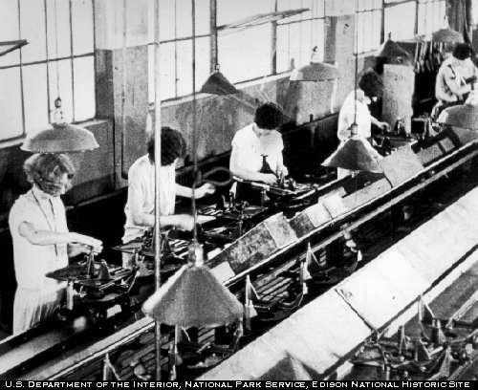
MAJOR CONCERNS
Continuous lagging performance of US students (including the top ones) on International Measures
Deficiencies of the NCLB
Demands of new economy
Misalignment of K-12
standards and college and
workplace skills and needs

Slide 6
WHAT’S THE DIFFERENCE
Aligned with college and career expectations
Internationally benchmarked
Broader focus in language arts
Increased level of cognitive complexity and rigor at all K-12 levels
Developed top down
Include both content and application of of knowledge through high-order skills
Will be assessed as traditional AND performance standards

Slide 7
THE STANDARDS
English-language arts and math were the first subjects chosen for the CCS because these two subjects are skills, upon which students build skill sets in other subject areas.
Science standards are in development
States can add up to 15% more to standards ( for state specific content, for example)
So far, only 5 states have not adopted CCS
Assessment of CCS will begin in 2014 ( 2013- benchmark test)
Smarter Balanced or PARCC (Florida is PARCC)
States join voluntarily – Florida joined in 2010

Slide 8
How to “ read” the standard
“unwrap” SKILLS ( verbs) and CONCEPTS (nouns) and determine level of cognitive complexity within standard’s context
CCSS.ELA-Literacy.W.5.8
Recall relevant information from experiences or gather relevant information from print and digital sources; summarize or paraphrase information in notes and finished work, and provide a list of sources.

Slide 9
Unwrapped standard
SKILL | CONCEPT | COMPLEXITY
Recall | Relevant personal experiences | 2 ( comprehension – because of relevant)
Gather | relevant information from print and digital sources | 5 ( synthesis)
Summarize Paraphrase | information in notes and finished work | 2 ( comprehension)
Provide | List of sources | 1 (recall)

Slide 10
AGENDA
Reasons for the transition to the CCS
The difference
Organization and structure of the Common Core Standards (CCS)
The Standards in ELA and Math
Implementation of Standards

Slide 11
MATHEMATICS
Include content standards for each grade level
Top down design
In addition to content, each standard has to embed and apply “ Standards for Mathematics Practice”
these are “varieties of expertise, processes and proficiencies integral to deep understanding and application of mathematics”

Slide 12
Design and Organization
Standards for Mathematical Practice
Carry across all grade levels
Describe habits of mind of a mathematically expert student
Standards for Mathematical Content
K-8 standards presented by grade level
Organized into domains that progress over several grades
Grade introductions give 2–4 focal points at each grade level
High school standards presented by conceptual theme (Number & Quantity, Algebra, Functions, Modeling, Geometry, Statistics & Probability)
Notes:
12
12

Slide 13
Design and Organization
Content standards define what students should understand and be able to do
Clusters are groups of related standards
Domains are larger groups that progress across grades
Notes:
13
13

Slide 14
Design and Organization
Grade Level Overviews

Slide 15
Design and Organization
Focal points at each grade level
Notes:
15
15

Slide 16
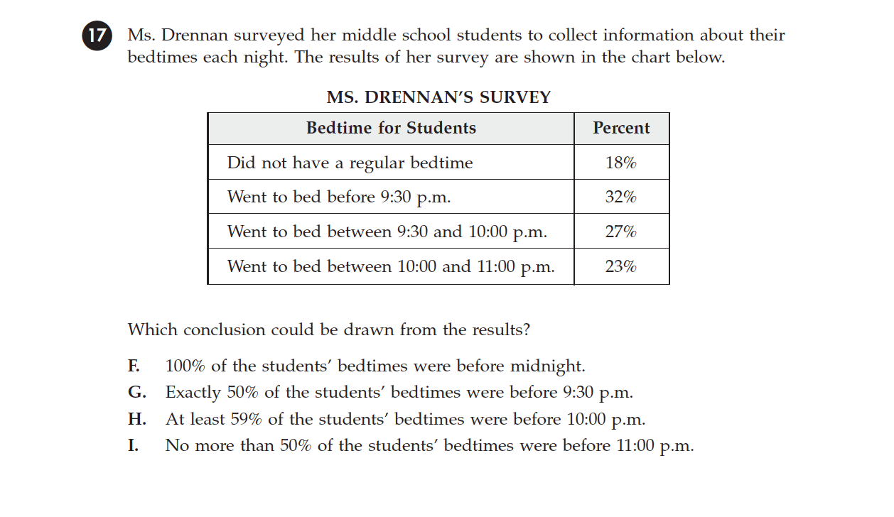

Slide 17
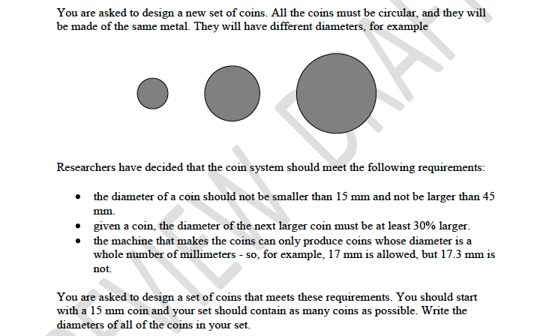

Slide 18
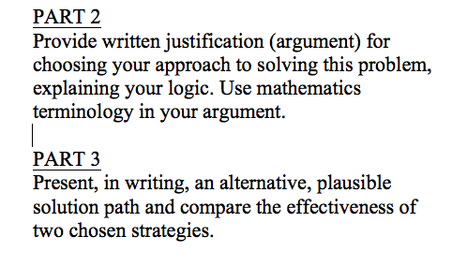
CONTINUED

Slide 19
Make sense of problems and persevere in solving them.
Looking for entry points to solutions by analyzing givens, constraints relationships and goals
make conjectures about the form and meaning of the solution and plan a solution pathway rather than simply jumping into a solution attempt
consider analogous problems, and try simpler forms of the original problem to gain insight into its solution; monitor and evaluate their progress and change course if necessary
explain correspondences between equations, verbal descriptions, tables, and graphs or draw diagrams of important features and relationships, graph data, and search for regularity or trends.
check their answers to problems using a different method; understand the approaches of others to solving complex problems and identify correspondences between different approaches.

Slide 20
Reason abstractly and quantitatively.
the ability to decontextualize—to abstract a given situation and represent it symbolically and manipulate the representing symbols as if they have a life of their own, without necessarily attending to their referents
the ability to contextualize, to pause as needed during the manipulation process in order to probe into the referents for the symbols involved
entails habits of creating a coherent representation of the problem at hand; considering the units involved; attending to the meaning of quantities, not just how to compute them; and knowing and flexibly using different properties of operations and objects.

Slide 21
Construct viable arguments and critique the reasoning of others.
Understand and use stated assumptions, definitions, and previously established results in constructing arguments.
Make conjectures and build a logical progression of statements to explore the truth of their conjectures
Justify their conclusions, communicate them to others, and respond to the arguments of others
able to compare the effectiveness of two plausible arguments, distinguish correct logic or reasoning from that which is flawed
Reason inductively about data, making plausible arguments that take into account the context from which the data arose.

Slide 22
Model with mathematics
apply the mathematics they know to solve problems arising in everyday life, society, and the workplace
apply assumptions and approximations to simplify a complicated situation, realizing that these may need revision later.
identify important quantities in a practical situation and map their relationships using such tools as diagrams, two-way tables, graphs, flowcharts and formulas.
analyze those relationships mathematically to draw conclusions.
routinely interpret their mathematical results in the context of the situation and reflect on whether the results make sense, possibly improving the model if it has not served its purpose.

Slide 23
Use appropriate tools strategically.
sufficiently familiar with tools appropriate for the task to make sound decisions about when each of these tools might be helpful, recognizing both the insight to be gained and their limitations
When making mathematical models, they know that technology can enable them to visualize the results of varying assumptions, explore consequences, and compare predictions with data.
able to identify relevant external mathematical resources and use technological tools to explore and deepen their understanding of concepts.

Slide 24
Attend to precision
communicate precisely to others; use clear definitions in discussion with others and in their own reasoning; state the meaning of the symbols they choose
careful about specifying units of measure, and labeling axes to clarify the correspondence with quantities in a problem
calculate accurately and efficiently, express numerical answers with a degree of precision appropriate for the problem context

Slide 25
Look for and make use of structure.
look closely to discern a pattern or structure
They also can step back for an overview and shift perspective.
They can see complicated things, such as some algebraic expressions, as single objects or as being composed of several objects.

Slide 26
Look for and express regularity in repeated reasoning.
notice if calculations are repeated, and look both for general methods and for shortcuts.
As they work to solve a problem, mathematically proficient students maintain oversight of the process, while attending to the details.
They continually evaluate the reasonableness of their intermediate results.

Slide 27
STANDARDS FOR
ENGLISH LANGUAGE ARTS
&
LITERACY IN
HISTORY/SOCIAL STUDIES,
SCIENCE, AND TECHNICAL SUBJECTS
Notes:
27

Slide 28
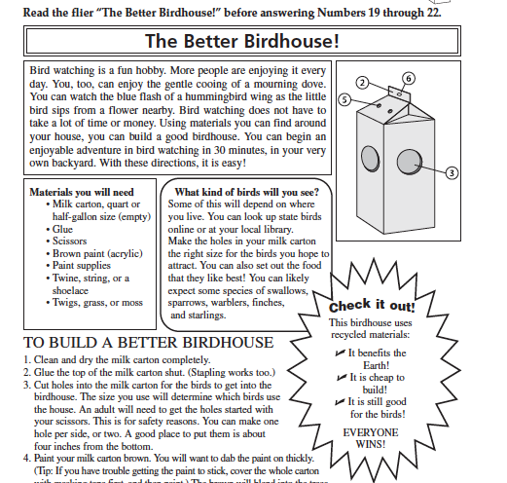

Slide 29
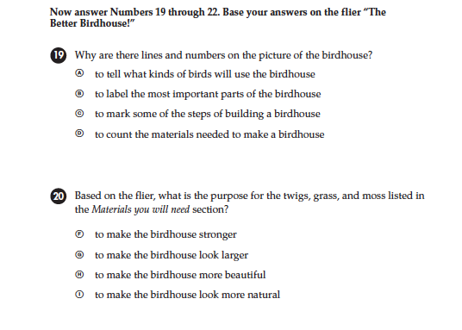
FCAT QUESTION- INFORMATIONAL TEXT GRADE 3

Slide 30
Assessment Task Example
Use 1-2 Stimuli for Grade 3; 2-3 for 4 and 5
Stimulus
Readings Video clips Audio clips Graphs, charts, other visuals Research topic/issue/ problem
Information Processing
Research questions Comprehension questions Simulated Internet search
Product/Performance
Essay, report, story, script Speech with/without graphics, other media Responses to embedded constructed response questions.
Emphasis on stimuli related to science, history, and social studies.
Notes:
For each component of a performance, a variety of elements may be included.
{+}
As an example, stimulus can be presented in a variety of formats including reading passages, video or audio clips, images, and topics that require research or investigation.
{+}
Information processing may occur by having students research specific questions or by asking them to think about specific aspects of stimuli to which they were exposed.
{+}
Products and performances can also take many forms including essays, stories, reports, and speeches. A wide variety of performance tasks may be developed by combining various stimuli, information processing tasks, and products.
{+}
The number of stimuli to be used for a performance task differs across grade levels, from one or two at grade 3 to as many as five at the high school level.
{+}
While stimulus materials should include a wide range of informational pieces, heavy emphasis should be placed on material involving science, history, or social studies content or themes that are consistent with the Common Core State Standards.

Slide 31
Parts of Performance Task
Part 1: Student reads multiple research sources and responds to constructed (extended) response prompts
Part 2: Based on collected evidence, student plans, writes, and revises his or her full essay or plans and delivers a speech
Notes:
All ELA performance tasks are composed of two parts.
{+}
The first part of performance tasks presents stimuli that serve as research sources that the student uses to answer an initial set of questions. These stimuli can be informational text, literary text, and audio or video presentations. The questions developed for part one may provide evidence about Claim 1, but most often will focus on Claim 4. The questions students are presented in the first part of a performance task should relate to the questions asked in the second part of the task.
{+}
The second part of a performance task requires the student to plan, write, and revise an extended response or to present a speech.

Slide 32
ELA
Give same importance to all components of LA – speaking/listening, reading and writing
Integrate these skills as TOOLS of learning content area ( THESE ARE NOT CONTENT AREA STANDARDS)
As students advance through the grades and master the standards in reading, writing, speaking, listening, and language, they are able to exhibit with increasing fullness and regularity these capacities of the literate individual.

Slide 33
Design and Organization
Four strands
Reading (including Reading Foundational Skills)
Writing
Speaking and Listening
Language
An integrated model of literacy
Media/ technology requirements blended throughout

Slide 34

Design and Organization
College and Career Readiness (CCR)
anchor standards
Broad expectations consistent across grades and content areas
Based on evidence
about college and
workforce training
expectations
Range and content
Notes:
34

Slide 35
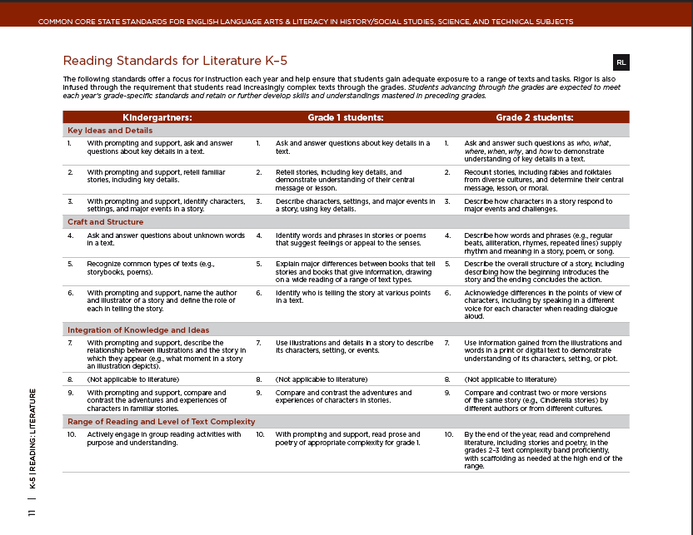
Design and Organization
K−12 standards
Grade-specific end-of-year expectations
Developmentally appropriate, cumulative progression of skills and understandings
Notes:
35
35

Slide 36
Students demonstrate independence.
Students can, without significant scaffolding, comprehend and evaluate complex texts across a range of types and disciplines, and they can construct effective arguments and convey intricate or multifaceted information.
Independently discern a speaker’s key points, request clarification, and ask relevant questions.
build on others’ ideas, articulate their own ideas, and confirm they have been understood
hey become self-directed learners, effectively seeking out and using resources to assist them, print and digital reference materials.

Slide 37
They build strong content knowledge.
establish a base of knowledge across a wide range of subject matter by engaging with works of quality and substance
become proficient in new areas through research and study.
read purposefully and listen attentively to gain both general knowledge and discipline-specific expertise.
refine and share their knowledge through writing and speaking.

Slide 38
They respond to the varying demands of audience, task, purpose, and discipline.
Students adapt their communication in relation to audience, task, purpose, and discipline.
They set and adjust purpose for reading, writing, speaking, listening, and language use as warranted by the task.
They appreciate nuances, such as how the composition of an audience should affect tone when speaking and how the connotations of words affect meaning.
They also know that different disciplines call for different types of evidence (e.g., documentary evidence in history, experimental evidence in science).

Slide 39
They comprehend as well as critique.
Students are engaged and open-minded—but discerning—readers and listeners.
They work diligently to understand precisely what an author or speaker is saying, but they also question an author’s or speaker’s assumptions and premises and assess the veracity of claims and the soundness of reasoning.

Slide 40
They value evidence.
Students cite specific evidence when offering an oral or written interpretation of a text.
They use relevant evidence when supporting their own points in writing and speaking, making their reasoning clear to the reader or listener
they constructively evaluate others’ use of evidence.

Slide 41
They use technology and digital media strategically and capably.
Students employ technology thoughtfully to enhance their reading, writing, speaking, listening, and language use.
They tailor their searches online to acquire useful information efficiently, and they integrate what they learn using technology with what they learn offline.
They are familiar with the strengths and limitations of various technological tools and mediums and can select and use those best suited to their communication goals.

Slide 42
They come to understand other perspectives and cultures.
appreciate that the twenty-first-century classroom and workplace are settings in which people from often widely divergent cultures and who represent diverse experiences and perspectives must learn and work together.
evaluate other points of view critically and constructively.

Slide 43
LINCOLN INTEGRATION
STEM units are built to integrate common core
Teachers have received (and continue receiving) extensive training in developing curriculum, lessons, and assessment matched to CCS
We already developed many authentic tasks geared directly to transitioning students to CCS

Slide 44
HOW CAN PARENTS HELP
Reward effort and persistence; speed is not always better
Allow students independence – work sent home is on the level that your student should do INDEPENDENTLY
Focus on PROCESS, not product
Expect and reinforce precision and accuracy; if there are careless errors – give them work back and have them INDEPENDENTLY find and correct them
Encourage you child to try to figure out solutions BEFORE asking for help; ask them “ What did you try so far?”
Reassure your child that it’s OK to be challenged by thinking and working outside their box and comfort level
Notes:
----- Meeting Notes (9/25/12 13:29) -----
bbb

Slide 45
SBAR SCORING WORKSHOP
Workshop for parents of K-2 students
Friday 9/28 at 7:55- 9:00 in the media center
How common core standards are assessed and progress reported

